Slide 1
Tagging 101

Slide 2

tagging

Slide 3
Learning Objectives
Describe how HTML code is used to create web pages
Identify common HTML tags
Create text that could be displayed as a web page using HTML tags
Notes:
Description
In this activity, learners explore how information like text and images can be presented to be easily readable/understandable, and how this works on the web using HTML tags. This activity explores how browsers work, how web pages are structured, the relationship between HTML tags and content.
Time Required
45 minutes to 1 hour, depending on group size
Audience
Can be tailored for audiences from 13 up; with varying levels of experience with the web.
Materials
Sticky notes
Pencils, markers
Laptop with Internet connection
Print cards with tags for TagTag Revolution or make your own on separate pieces of paper, write the following “tags” (be sure to include the arrow!):
Open tags: “ →” (also sing, stomp, spin, shake).
Close tags: “ ←” (also sing, stomp, spin, shake).
Web Literacy Skills
Code
Design
21st Century Skills
Communication
Collaboration
Creativity
Earning Digital Badges
Digital badges capture the evidence and are the demonstration knowledge and achievement. Each Core Activity encompasses multiple web literacy skills. Completion of all Core Activities will enable anyone to earn all web literacy plus 21C skills badges. Thus, we encourage you to complete all the Core Activities, and earn badges to capture what you’ve learned. Digitalme is offering web literacy badges through the Open Badges Academy.

Slide 4
Introduction
The Internet is a system of interconnected computers
World wide web is a system of interconnected pages that lives on the Internet.
Web sites are spaces to access, share, and interact with multimedia content.
HyperText Markup Language or HTML is used to make web pages
Access the web, you’re using a piece of software called a browser to display pages.
We’re going to explore HTML today, specifically how we use HTML to make our content – text, images, etc– readable by browsers and easy for humans to read and understand.
Notes:
[3 min]
Review core concepts, frame and connect this topic to a big idea. Explain:
The Internet is a system of interconnected computers, and the world wide web is a system of interconnected pages that lives on the Internet.
Web sites are spaces to access, share, and interact with multimedia content.
The people who build the web– web developers and designers– use a computer coding language called HyperText Markup Language or HTML to make web pages
When you access the web, you’re using a piece of software called a browser to display pages.
Tip! Ask who knows some examples of web browsers.

Slide 5
Content & Tags
For this activiy, you need two visual aids:
the front page of a newspaper showing images, headlines, bylines, text, paragraphs, columns
the text and images from that front page stripped of all formatting, in the same size font, with no paragraphs, columns, etc, printed out on a single page. You can do this by accessing a digital copy of a print edition newspaper such as the New York Times selecting all the content and copy-pasting it into a Text Editor, and removing all formatting (via the “make plain text” command). You may have to do a bit of extra editing to strip out all formatting. Aim is to show students a typical front page of a paper, plus the content as a continuous, uniform block of text.
Show learners the two pages; tell them the content is the same on both pages.
Discuss together– what is the difference here? What’s missing? Which page is more eye catching? Which page is more interesting? Which is easier to read? Why?
Discuss together how elements like headlines, columns, bylines, different font sizes and blocks of text help organize content and direct our eyes to what is important on the page.
Tip! Keep a list of the design elements that come up in discussion–map these to HTML tags later on in the lesson.
Key Concept! Explain that this is how web designers use HyperText Markup Language: to add formatting to content on the web, so browser can display it in a way that’s easy to read, and interesting.
Web designers use HTML “tags” to tell the browser what to do with content.
Ask learners, what’s a tag? Where do you have tags? What do they do > Tip! If learners are struggling, explain: You have tags on your clothes or your luggage, people tag you on social media, you might tag a blog post… A tag is a little bit of information you attach to something, to identify it in some way, or add special instructions.
Explain: When web designers write HTML, they take chunks of content and “mark them up” with tags to tell the browser how to show that content. They put a tag at the beginning of the content (the opening tag), and a tag at the end (the closing tag), so the browser knows when to start and stop.
Explain the rules for tagging are:
Tip! Visuals are really useful here– write or project an example (as below) where everyone can see it.
When we want to tag some content, we surround it with a matching pair of words, each word surrounded by a set of brackets “< >”.
Here’s an example tag:
Tag the World
Tip! ask learners, in this example, what is the title?
When tags are used online, the brackets alert the browser software that it’s a tag. The word or character inside each bracket tells the browser important information about what’s inside.
is an opening tag– signaling that the tagged content starts here.
You can see there’s something different about the second word- bracket set
the backslash means it’s a CLOSING tag– telling the browser the tag is finished.
We ALWAYS use opening and closing tags to surround content.
With very few exceptions, tags are ALWAYS matched with content, just like the tag examples we discussed.
Tell learners that now we’ll experiment with the CONCEPT of tags and tagging in offline activities, before we dive in and see how they work online
Notes:
(5-7 mins)

Slide 6
The Times
NHS must justify its £270,000 pay deals, says care minister
Chris Smyth, Whitehall Editor
The NHS must explain the “exceptionally high levels of pay” given to senior managers, the care minister has said.
Helen Whately outlined her concerns after it emerged that the health service was hiring dozens of senior managers on salaries of up to £270,000, at a time when the government has announced billions more in funding to help it tackle backlogs.
Conservative MPs said yesterday that ministers were “throwing other people’s money down a bottomless pit” and that a £12-billion-per-year package was at risk of being swallowed by an NHS “black hole”.
At the debate on the health and social care levy several Tory MPs urged the government to set clearer targets for the NHS
At the debate on the health and social care levy several Tory MPs urged the government to set clearer targets for the NHS
UK PARLIAMENT/JESSICA TAYLOR/PA
Asked on Times Radio about the jobs with salaries of up to £270,000, Whately said: “It’s clearly a big number. I am concerned when I see — and I get briefings on — exceptionally
KPMG aims for a third of its staff to be working class
Louisa Clarence-Smith, Chief Business Correspondent
All staff at the accounting firm will receive training on “invisible barriers” that exist for certain groups of workers
All staff at the accounting firm will receive training on “invisible barriers” that exist for certain groups of workers
ALAMY
The accounting and consulting firm KPMG has become the first big business in Britain to set a target for the number of working-class staff.
It is aiming for 29 per cent of its partners and directors to come from the social group by 2030. It defined working class as having parents with “routine and manual” jobs, such as plumbers, electricians, butchers and van drivers.
All its 16,000 employees will receive training on “invisible barriers” that exist for people from lower socio-economic backgrounds. The firm said that 23 per cent of its 582 partners and 20 per cent of its 1,297 directors were from working-class backgrounds. Those from such backgrounds were typically paid 8.6 per cent less than those whose parents worked in “higher managerial, administrative
French accuse Priti Patel of ‘blackmail’ on Channel migrants
Rift deepens over threats to block boats and withhold money
Matt Dathan, Home Affairs Editor | Adam Sage | Steven Swinford, Political Editor | Eleni Courea A child is helped ashore from the Border Force boat BF Hurricane in Dover yesterday
A child is helped ashore from the Border Force boat BF Hurricane in Dover yesterday
PETER NICHOLLS/REUTERS
France has accused Britain of “financial blackmail” over the migrant crisis as a diplomatic rift between the countries deepens.
Gérald Darmanin, the French interior minister, publicly rebuked his counterpart Priti Patel this morning, referencing her threat to withhold £54 million from France if Channel crossings continue to escalate.
Darminin and Patel met in London yesterday for what were described in Paris as “very tense” talks over British demands for French police to stop more boats. She has offered to pay £54 million to France to double their patrols of the shoreline but threatened to withhold this if the country’s authorities fail to hit a rate of 75 per cent.
“France will not accept any practices that are contrary to maritime law, nor any financial blackmail,”

Slide 7
Compare The Times
* What is the difference here?
* What’s missing?
* Which page is more eye catching?
* Which page is more interesting? Which is easier to read?
* Why?

Slide 8
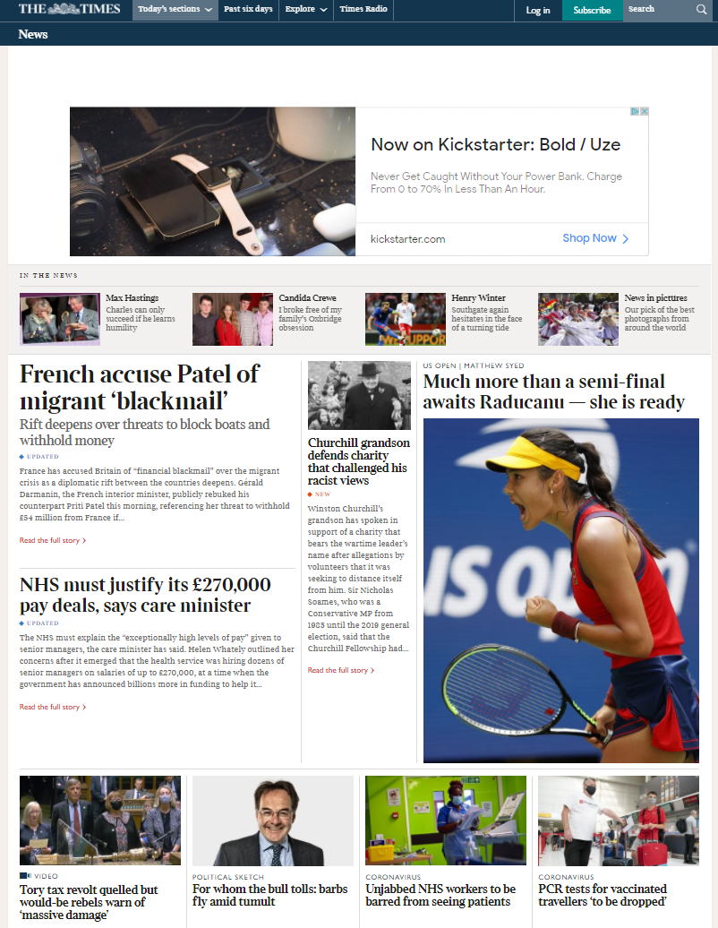

Slide 10
Offline: Tag The World
When we want to tag some content, we surround it with a matching pair of words, each word surrounded by a set of brackets “< >”. Here’s an example tag:
<title> Tag the World </title>
We ALWAYS use opening and closing tags to surround content.
Make your own tags and hang them up!
Notes:
[10 mins]

Slide 11
Offline: Tag Tag Revolution
Introduction: Explain to participants that they are about to have a fun dance party to show them how HTML tags assign instructions to content.
Steps:ask learners, in this example, what is the title?
Arrange the players into a circle, making sure there is enough room to walk around the outside of the circle.
Tip! This game is best played with groups over 10. If you have a larger group, you may want to add some extra tags. If you have a small group you may want to use fewer. Feel free to make up your own.
Select two players from the group to be the “Coders”. Hand one of them the first open tag and the other one the corresponding closed tag. Start with an easy one like and .
Start the music and have the two Coders walk around the outside of the circle while the other players stand still. Make sure the Coders keep a little distance between them. You could have them start walking five paces from each other.
When you stop the music, the Coders attach the tags to the members of the circle they are standing closest to. Remember that tags must surround content.
Everyone who is standing in between the arrows of the open tag and closed tag ; will now have to start clapping (the people wearing the tags, don’t have to). The clapping players should continue to clap for the rest of the game.
Now select two new tags and hand them to the Coders (for instance and ).
Repeat steps 3 & 4. This time, when the Coders hand over the tags, anyone who is between the tags will have to sing. If any players are between both the tags AND the tags, then they will have to clap AND sing.
Continue these steps again with the rest of the tags (and any other tags you want to add the game) to make a fun, complicated tag dance party! When the Coders have the final tags, ask them to join the circle wherever they are once the music stops (instead of handing the tags to people in the circle). Everyone standing between the tags the Coders are holding performs the actions on their tags.
After all the tags have been used, you could have the players with tags move around one at a time to change up who is doing what. This will help help learners understand how tags are applied to content, how they open and close, in HTML.
Here in the real world, you have complete freedom to make their own tags names– later we’ll see that in the coding language HTML, we use a restricted set of tags names that everyone agrees upon, that make sense for web content. But for now, make up whatever tag you want.
Notes:
[10 mins]

Slide 12
Lets look at some webpages (then press ctrl+u)
Very simple http://utcsheffield.github.io/utc-sheffield/
More complex Amazon.co.uk: Low Prices in Electronics, Books, Sports Equipment & more

Slide 13
Tags In Action
Use paper tags to mark up the article you have been given
Keep it simple only use html, body, h1, h2, h3, p, a, img
<html>
</html>
<p>
</p>
Notes:
[15 mins]
Introduction: Explain that we’ve seen what tags look like, and how they work with content (what’s inside the tags). Now let’s practice using some real tags that are part of the HyperText Markup Language (HTML).
First, let’s check out a simple HTML document– guess what– from a web designer and developer, when they are building web pages, what they are working with is HTML code in a simple text file.
Tip! Open a simple HTML document in a text editor– NotePad for PC and TextEdit for Mac, and also show it in a browser. Point out the tags in the document, and and show what they do. Suggested basic tags: h1, h2, h3, p, a, body. You can also show a more complex document (use View Source in the browser) to show that all web pages are text and code interpreted by the computer.
These tags have agreed-upon meanings, so that both web developers and the people that write the browser software understand what they mean. The only reason why these tags work is because of those agreements– if you try to use some of your fun tags from “Tag the World” or “Tag Tag Revolution” on a web page, you won’t see anything, sadly.
Tip! If learners are confused about what kind of tags would be relevant in HTML, remind them that HTML stands for “HyperText Markup Language”– that we assign tags to text content. Ask: why would “paragraph” be an HTML tag, and not “clap” or “sing”
When you use these tags, you’re writing HTML! And when the browser sees them, it will transform your web page from a boring block of text to something interesting and easy to read.
Let’s Tag! Get learners to add tags to some existing content.
OFFLINE, For this part, you’ll need some content– maybe a fun news story or a biography of someone, or some other interesting content, printed out big on 11x 7 sheets, and chopped up into chunks– paragraphs, headings, links, etc. You’ll also need some sticky note or paper slips for tags. Either write out the tags, or let learners create the (from the list only). Split users into small groups and give each group a collection of text and of tags.
ONLINE, For this part you will need a text file with some basic unformatted content in it, same type as above. First ask users to save the file as .html. Explain the purpose of the
and
tags. Then set them loose to type in their tags!
Tip! For ONLINE, create a text file with the content, and have users edit it with THE MOST BASIC text editor– Notepad on a PC or TextEdit on a Mac– in plain text mode. Facilitator may need to explain the head, title tags.
Explain to learners that they need to first surround all the content with the body tags– let the browser know that all the content here is for display on the web!
Ask learners to organize the content using the tags. Find the biggest most important headings, break up the paragraphs, add small headings, and look for stuff that can be hyperlinks. Walk around the room and help here and there.
At the end of the exercise, if possible, both online and offline learners should see the page loaded into a browser. Online learners can save and open their .html file in a browser. For offline learners, the facilitator should if possible show the finished page on a computer and monitor.
Explain to users that these files are still on their local computers, and viewable only there. You haven’t yet put them “online” on a server, where others can find it, so they’re not on the web.
Tip! Remind users of the Map the Web activity, to help them visualize how their client computer is connected. They can access content on web servers, but other computers on the web can’t access the clients files.
Learning Experience Reflection
[5 mins]
What did you like about this activity?
If you might teach this activity to a particular audience, what might you change about the process, structure, or content to better meet the needs of that audience?
Feedback on Core Curriculum
Tell us how and where you’re using the curriculum and what you’ve learned and what you might change.

Slide 14
mozilla
Mozilla is a global non-profit dedicated to putting you in control of your online experience and shaping the future of the web for the public good. Visit us at mozilla.org

